Slide 1

INTERFACING ESP8266 WITH ESP32CAM AND ESP32 WIFI CONNECTIVITY
SUBMITTED BY:AMANDEEP SINGH
STUDENT ID:C0761298
GROUP :2
SUBMITTED TO :MIKE ALESHAMS

Slide 2

IOT BASED BANK LOCKER SECURITY

Slide 3
TABLE OF CONTENTS
PROJECT OVERVIEW
REQIREMENTS
Hardware requirements
Software requirements
INTRODUCTION TO ESP8266
Pin Layout
Features
INTRODUCTION TO ESP32 CAM
Pin Layout
Features
INTERACING
Communication Protocol
Schematic Diagram
Connections
Coding
TERMINAL OUTPUT
REFERENCES

Slide 4
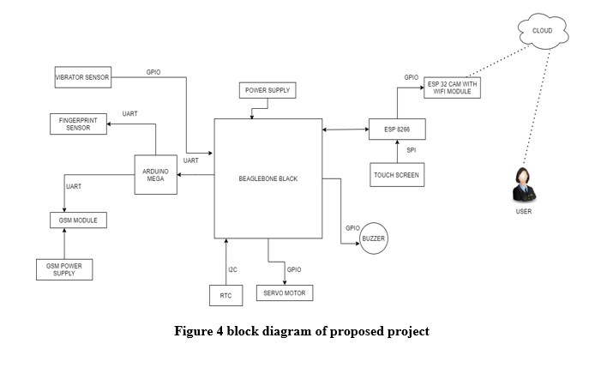
PROJECT OVERVIEW

Slide 5
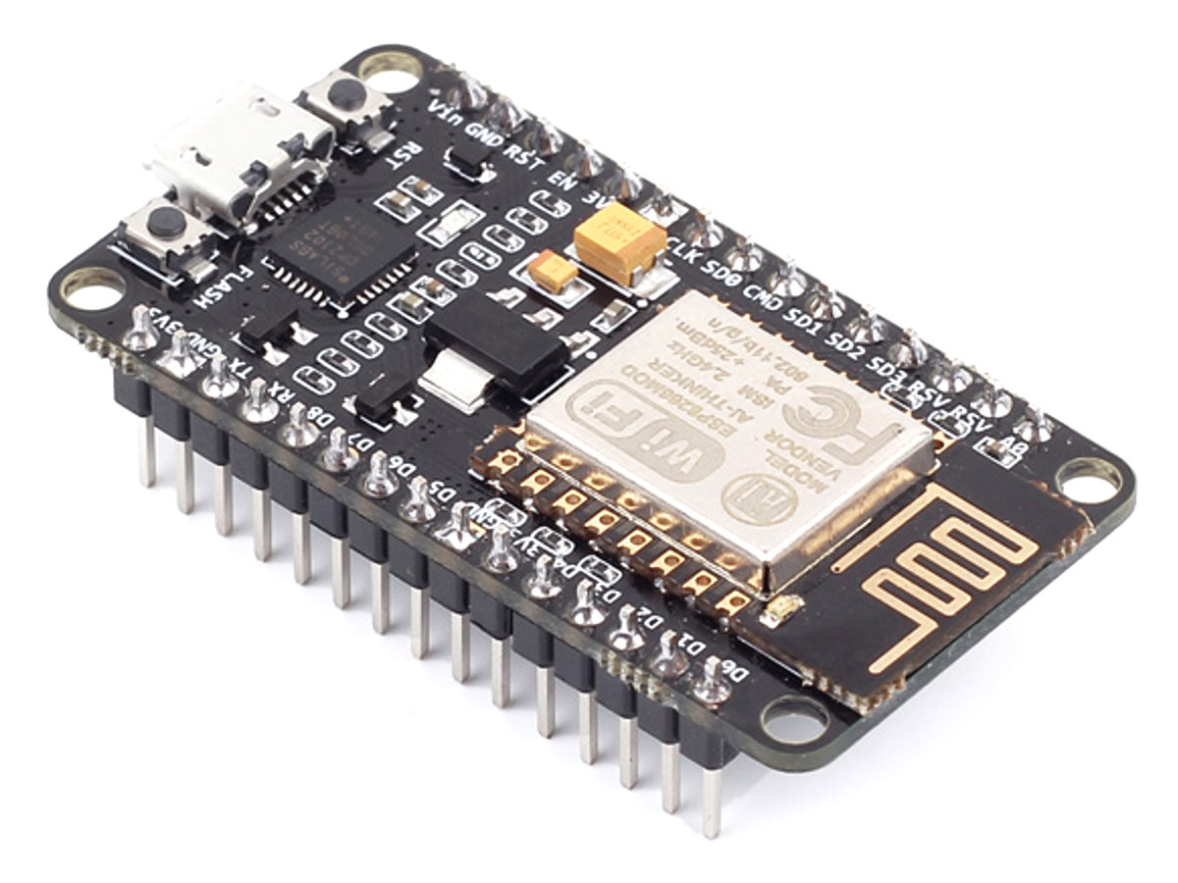
REQUIREMENTS
For this task there are some hardware components and software.
This Photo by Unknown Author is licensed under CC BY-SA

Slide 6

HARDWARE REQUIREMENTS
ESP8266
ESP32 CAM
JUMPER WIRES
USB CABLE TO CONNECT ESP8266 TO HOST MACHINE

Slide 7

SOFTWARE REQUIREMENTS
ARUINO IDE
This Photo by Unknown Author is licensed under CC BY-SA

Slide 8

ARDUINO IDE
The Arduino software is published as open-source tools, available for extension by experienced programmers. The language can be expanded through C++ libraries.
It is used to write and upload programs to Arduino compatible boards, but also, with the help of third-party cores, other vendor.

Slide 9
INTRODUCTION TO ESP8266
The NodeMCU (Node Microcontroller Unit) is an open-source software and hardware development environment built around an inexpensive System-on-a-Chip (SoC) called the ESP8266.
The ESP8266, designed and manufactured by Espressif Systems, contains the crucial elements of a computer: CPU, RAM, networking (Wi-Fi), and even a modern operating system and SDK.
This Photo by Unknown Author is licensed under CC BY-SA

Slide 10
FEATURES
The operating voltage for this board is 3.3V
There are 16 GPIO line available some of them are used internally for devices like flash memories
2 pins out of 11 GPIO are reserved for the are reserved for communication Rx and Tx pins
D0 to D8, total 9 pins are used as GPIO pins.
SD1, CMD, SD0, CLK are four pins for SPI communication.
Two buttons are present on the board for flashing the device and reset.

Slide 11
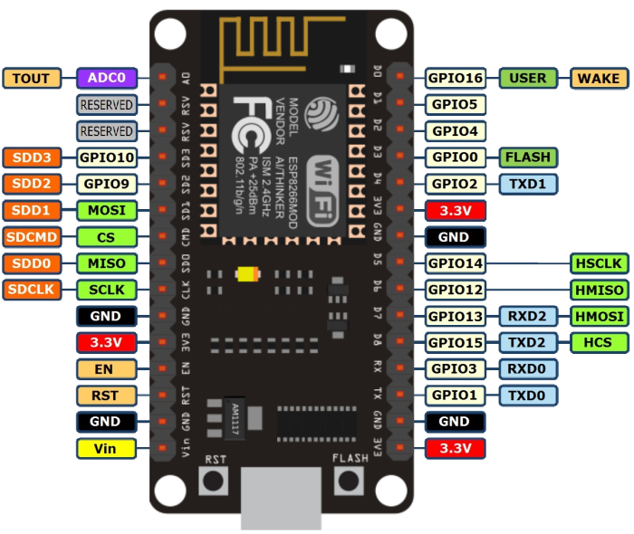
PIN DISCRIPTION

Slide 12
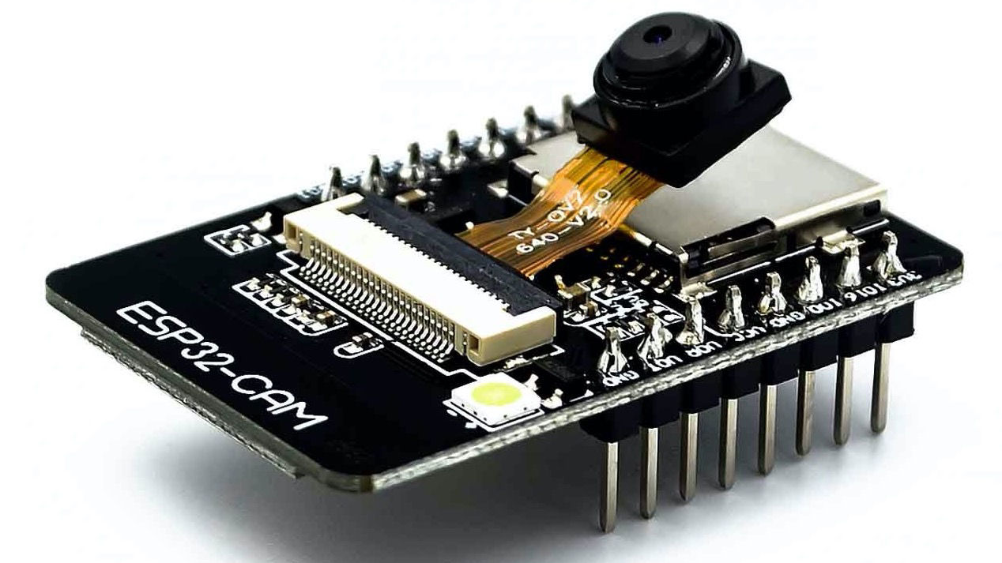
ESP 32 CAM MODULE
FEATURES:
Low power 32-bit CPU
Clock speed up to 160MHz
Built-in 520 KB SRAM, external 4MPSRAM
Supports UART/SPI/I2C/PWM/ADC/DAC
Support OV2640 and OV7670 cameras
Support image Wi-Fi upload
Embedded FreeRTOS.
Support for serial port local and remote firmware upgrades (FOTA)
This Photo by Unknown Author is licensed under CC BY-SA-NC

Slide 13
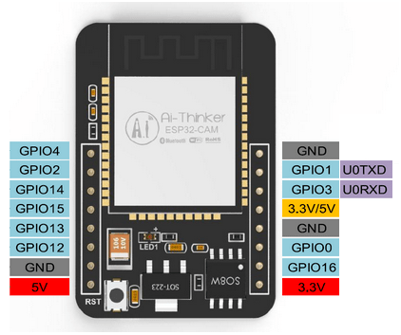
PIN DISCRIPTION

Slide 14
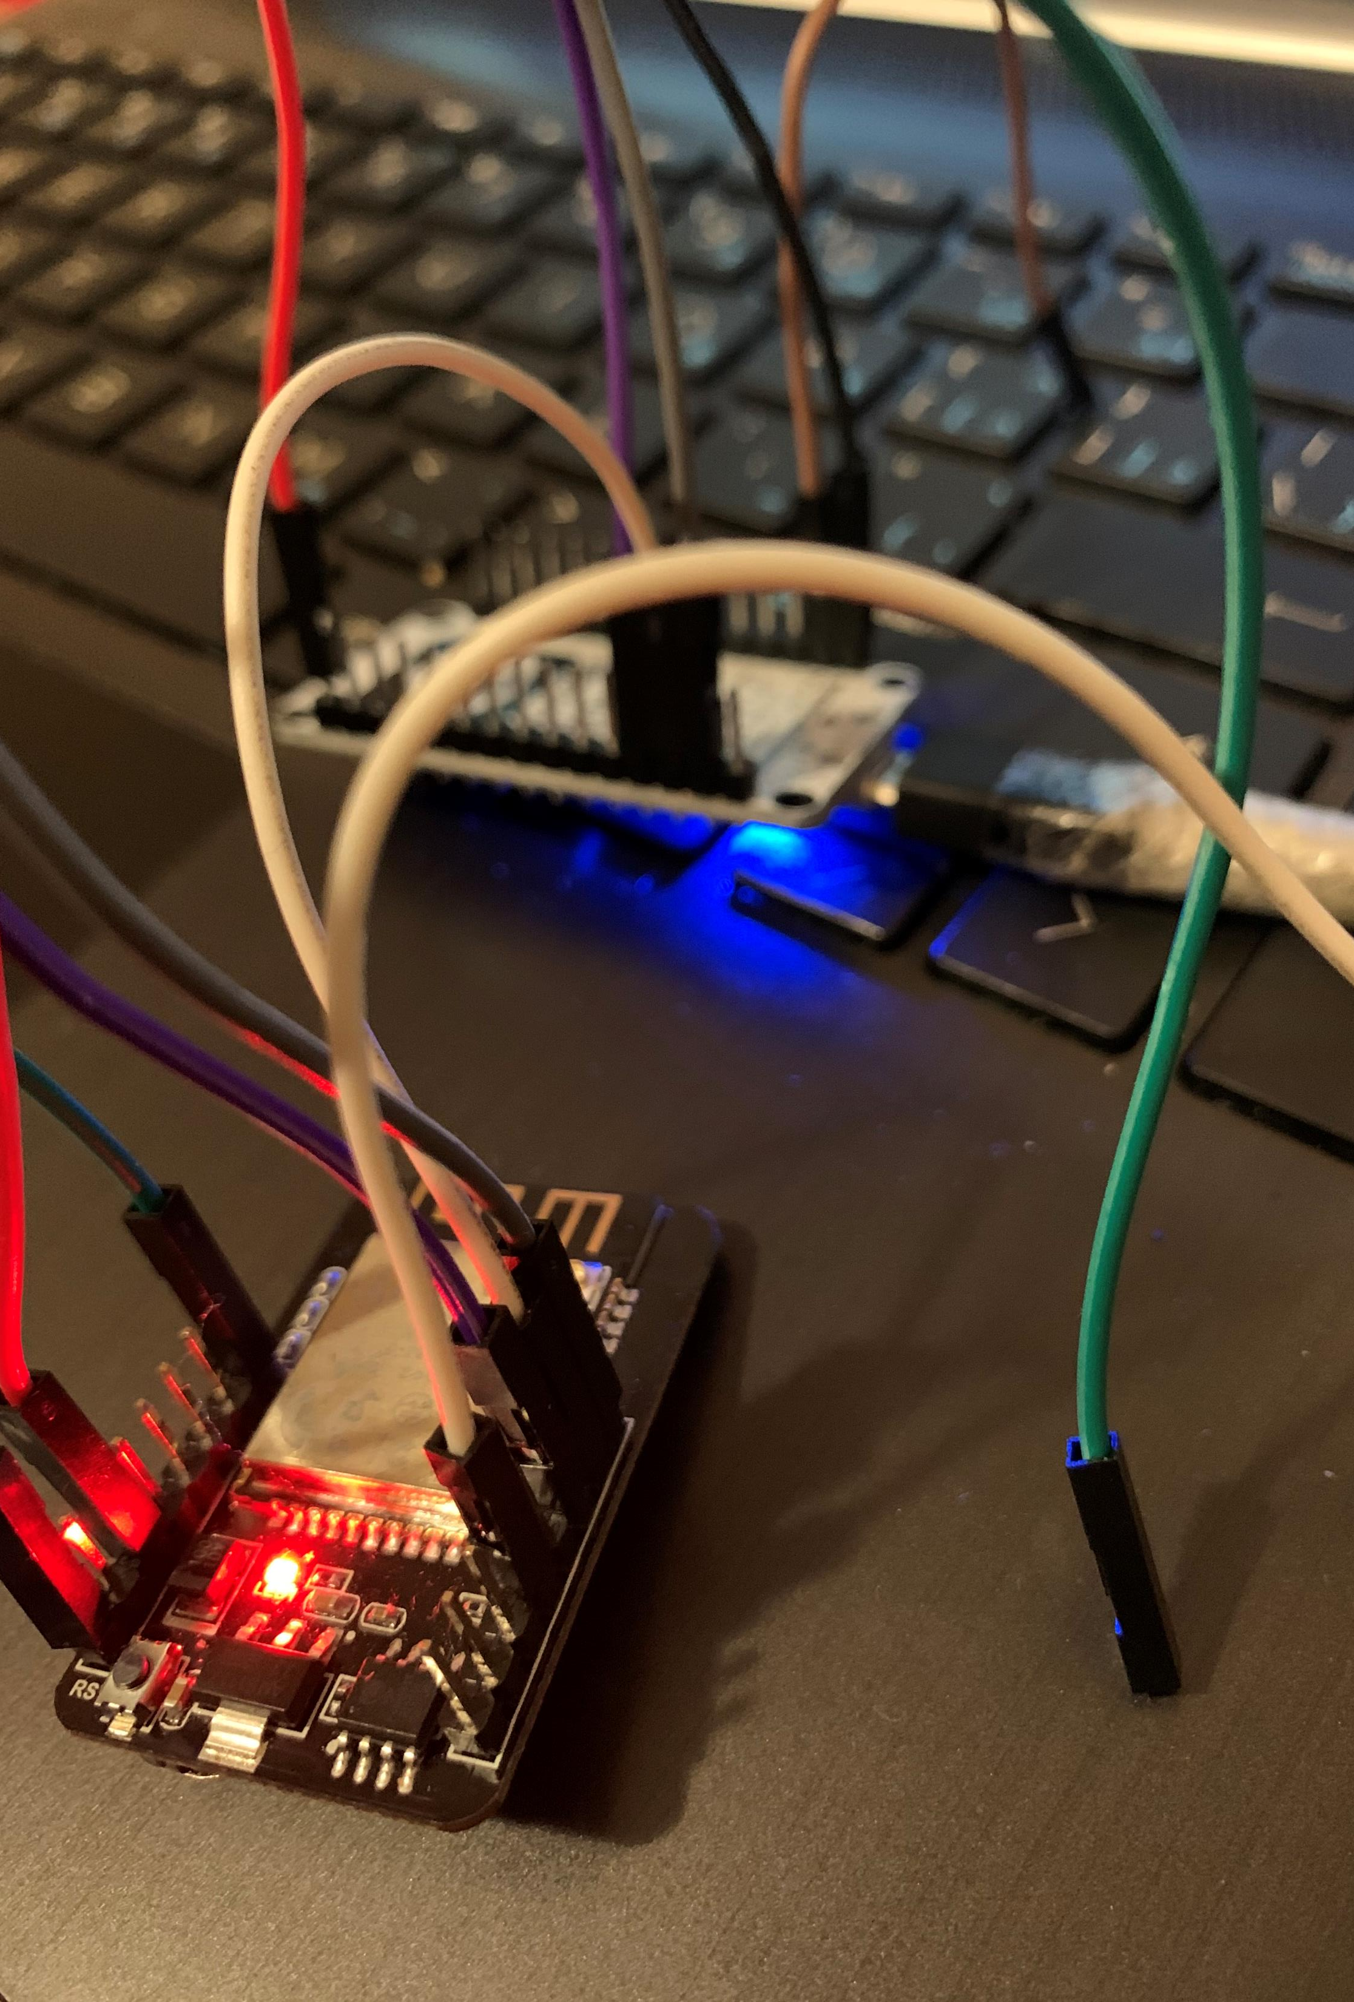
ROLE OF ESP32 CAM MODULE
CAM 32 module is being used for two tasks in this project and these are:
To provide the Wi-Fi to the system so that Internet access is possible .
To capture the picture of the unauthorized person who tries to access the locker.

Slide 15

COMMUNICATION PROTOCOL
ESP 8266 and ESP32 CAM Modules are connected to the each other using GPIO pins.
A GPIO is a signal pin on an integrated circuit or board that can be used to perform digital input or output functions.
By design it has no predefined purpose and can be used by the hardware or software developer to perform the functions they choose. Typical applications include controlling LEDs, reading switches and controlling various types of sensors.

Slide 16
INTERFACING OF ESP32 WITH ESP8266
ESP 8266 | ESP 32 CAM MODULE
Vin | 5V
GND | GND
AD0 | I016
Mode of communication is GPIO and how these two devices are connected can be shown above.

Slide 17
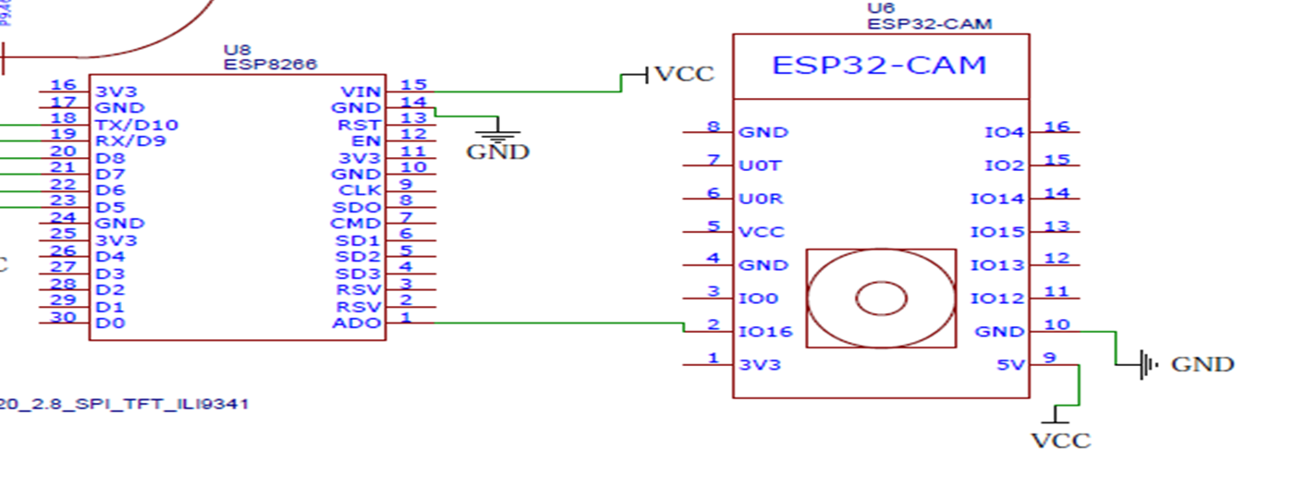
SCHEMATIC DIAGRAM

Slide 18
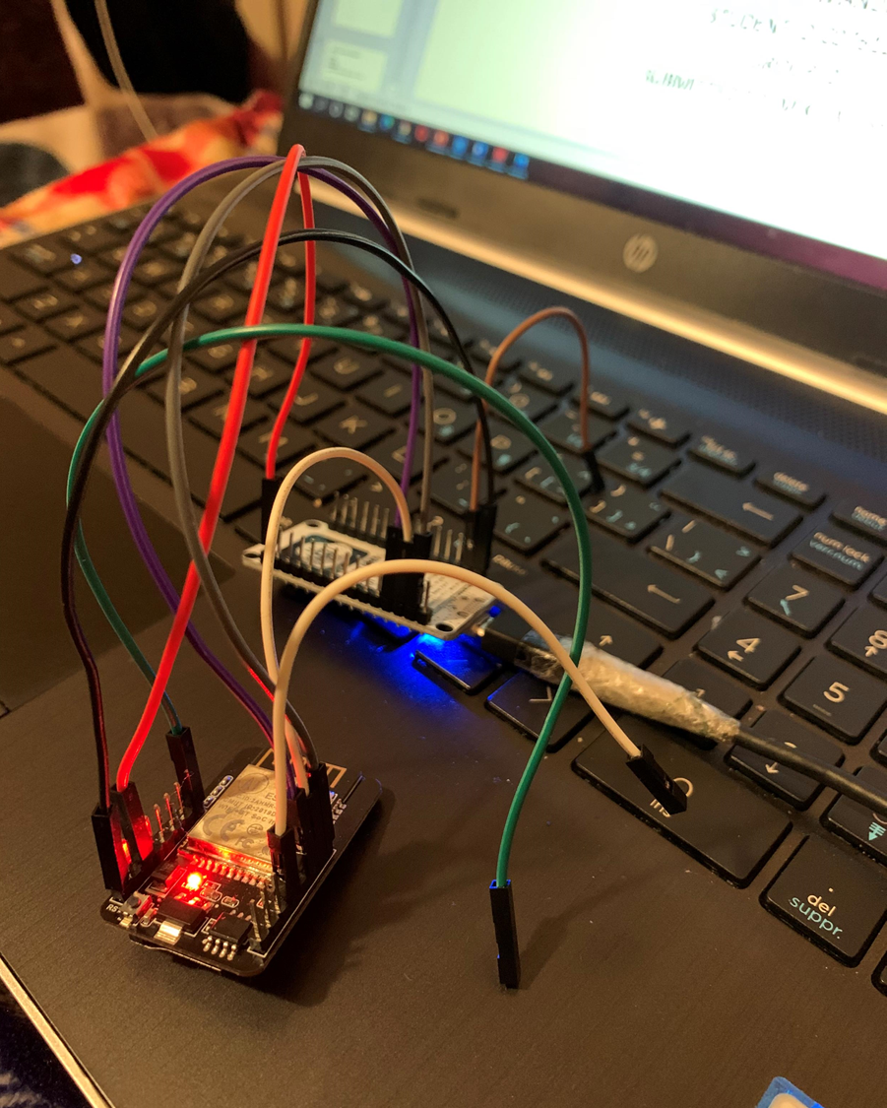
CONNECTIONS

Slide 19
ESP 32 CAM IN FLASHING MODE
GPIO 0 determines whether the ESP32 is in flashing mode or not. This GPIO is internally connected to a pull-up 10k Ohm resistor.
When GPIO 0 is connected to GND, the ESP32 goes into flashing mode and you can upload code to the board.

Slide 20
HOW TO UPLOAD CODE ON ESP 32 CAM??
As there is no USB port available on esp32 cam module. So, to upload the code on this board there are different ways
First way is that we can take help of FTDI Programmer
Second option is that is that we can take help of ESP8266.
Upload code through the U0R and U0T pins (serial pins).

Slide 21
HOW TO UPLOAD CODE ON ESP 32 CAM??
ESP 8266 | ESP 32 CAM
Rx | UOR
Tx | UOT
GND | GND
Vin | 5V
Firstly, make the connections as shown in the table.

Slide 22
HOW TO UPLOAD CODE ON ESP 32 CAM??
There are few things that we need to consider while uploading the code to Esp 32 cam module.
Make sure that the ESP 32 is in flash mode. Make connections as shown in the table .
Connect EN pin and GND pin of ESP8266 with each other.
Connect Io0 to GND pin of ESP32CAM with each other.

Slide 23
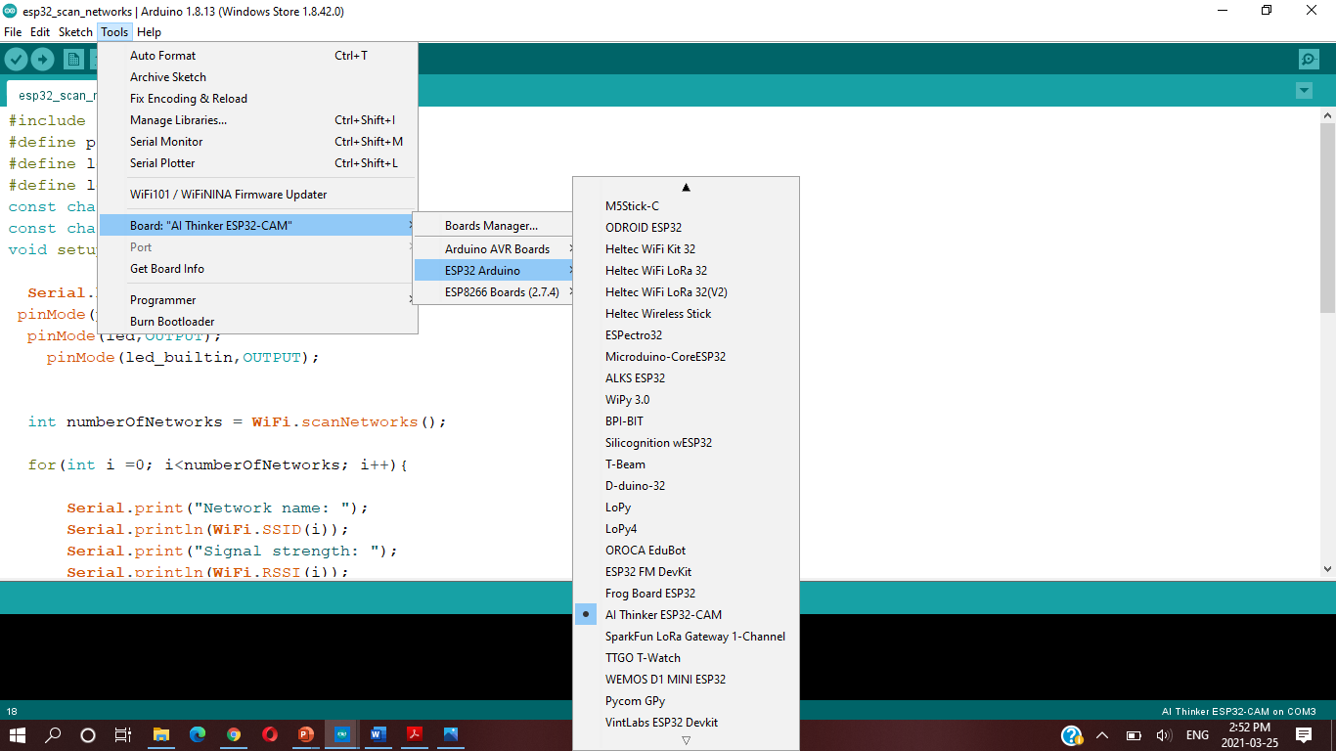
CODING

Slide 24
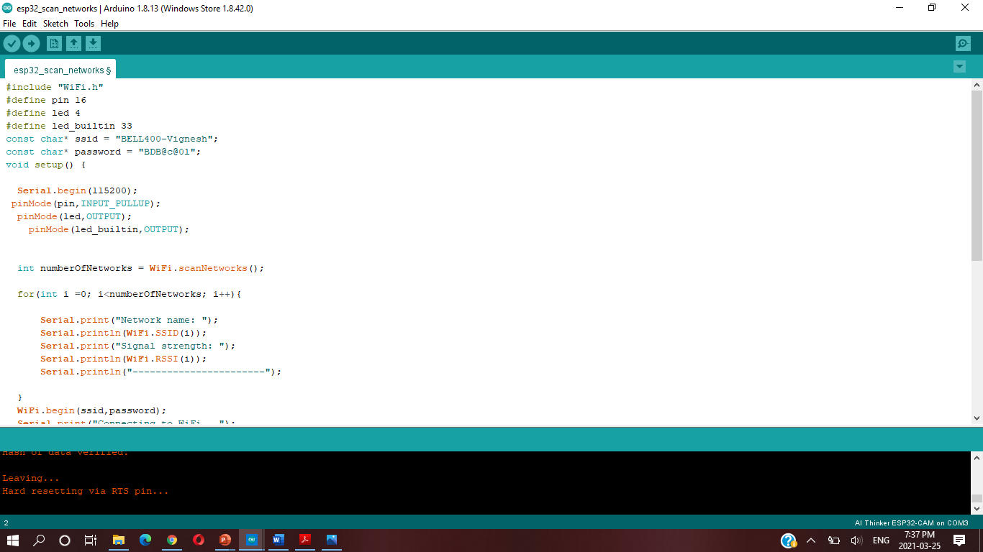
CODING

Slide 25
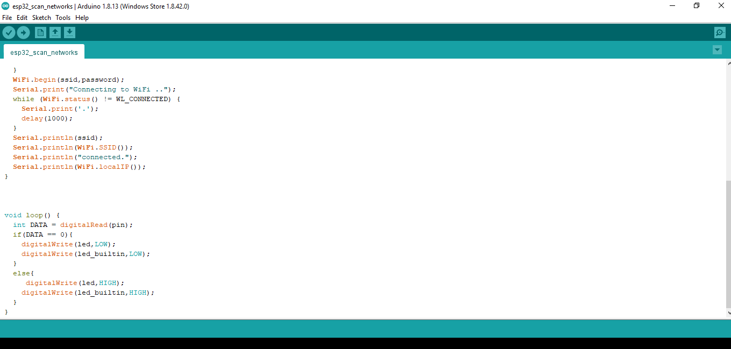
CODING

Slide 26
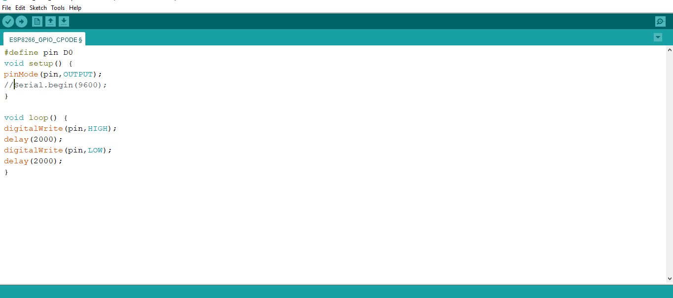
CODING

Slide 27
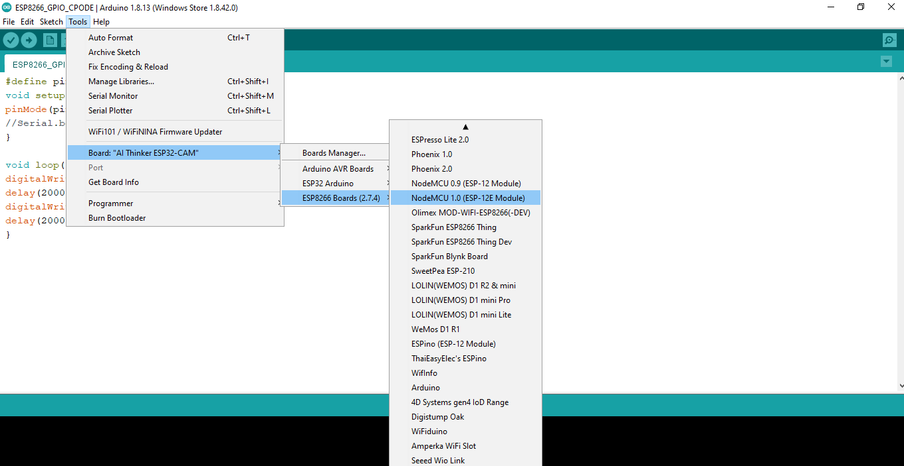
CODING

Slide 28
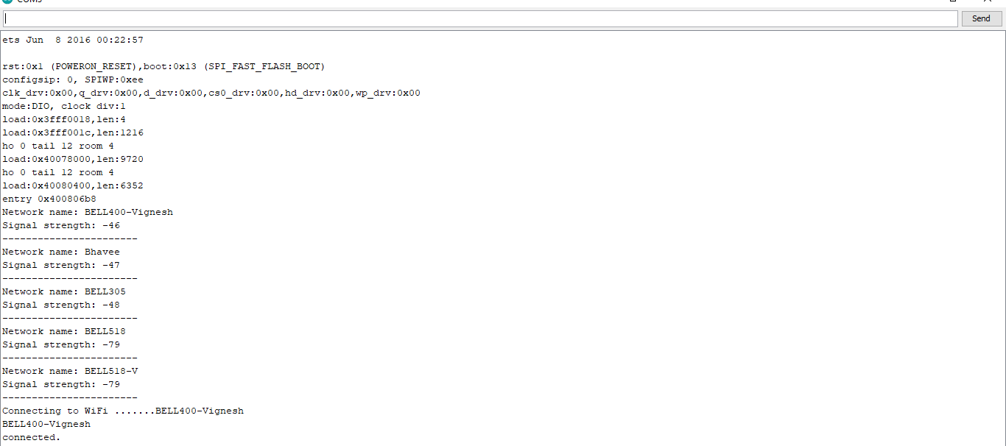
OUTPUT

Slide 29
REFERENCES
https://randomnerdtutorials.com/esp8266-pinout-reference-gpios/
https://www.make-it.ca/nodemcu-arduino/nodemcu-details-specifications/
https://randomnerdtutorials.com/esp32-cam-video-streaming-face-recognition-arduino-ide/
https://www.instructables.com/Programming-ESP32-CAM-With-ESP8266/
https://www.ics.com/blog/introduction-gpio-programming
https://www.metageek.com/training/resources/wifi-signal-strength-basics.html

Slide 30

REFERENCES
https://randomnerdtutorials.com/esp32-cam-ai-thinker-pinout/

Slide 31

THANK YOU

